Slide 1


Daraz Ecommerce ChatBot Using RAG To Improve Customer Interaction
Presented By: Moiz Zulfiqar (24543), Abdullah Maqsood(24448) & Muhammad Zauraiz (24486)

Slide 2

Introduction To The Project
Overview: This project introduces a Retrieval-Augmented Generation (RAG) system tailored for Daraz eCommerce to address and answer customer and seller inquiries efficiently. Our system utilizes cutting-edge text analytics to interpret and respond to natural language queries, sourcing accurate information from a robust dataset.
Objective: The primary goal is to streamline the customer support process by providing immediate, accurate responses to inquiries about products, policies, and seller guidelines, thereby enhancing the overall user experience on Daraz.

Slide 3

Data Collection Phase

Slide 4

Main Data (15 Documents): Includes comprehensive guides on policies, manuals, and partnerships, essential for addressing general customer inquiries.
Overview of Data Utilized
Seller Data (9 Documents): Contains detailed information on seller account management and affiliation programs, crucial for supporting Daraz’s seller community.
Product Data (Over 400 Products in 10+ Categories): Facilitates specific product inquiries, ranging from availability and specifications to pricing and seller performance, ensuring customers find exactly what they need.

Slide 5

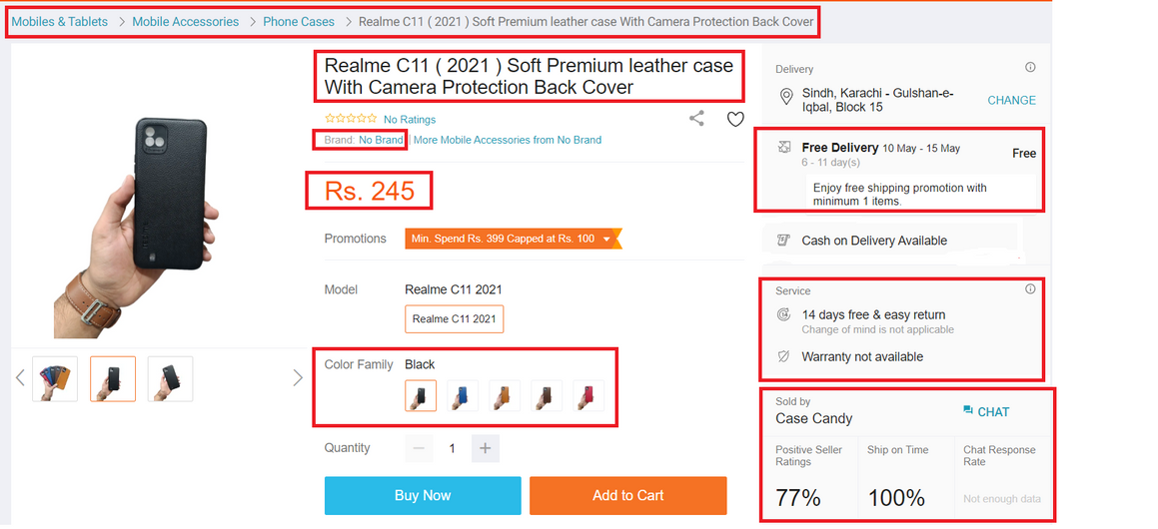
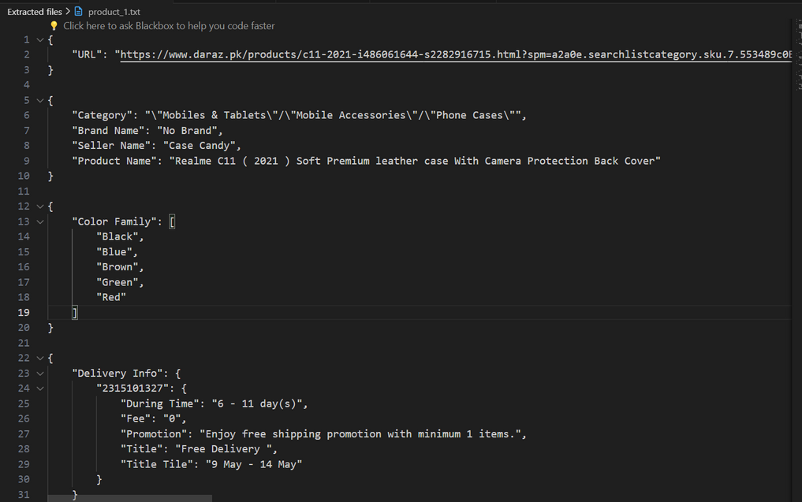

Scrapping Products From Daraz Website
Data Extraction Steps:
Located products on Daraz and copied the URL of the results page.
Used Python to automate the extraction of product links from the results page.
Targeted the 'productURL' tag to fetch links for each listed product.
Detailed Data Scraping:
Ran a Python script for each product link to extract detailed information.
Scraped data by targeting specific HTML tags.
Handling Complex Data using Regex:
Developed regex expressions to capture data not directly accessible via HTML tags.
Ensured comprehensive data extraction for nuanced product details.
Data Storage in JSON Format:
Stored extracted information in individual text files for each product.
Used JSON format to maintain structured and accessible data.

Slide 6
Retrieval Phase

Slide 7
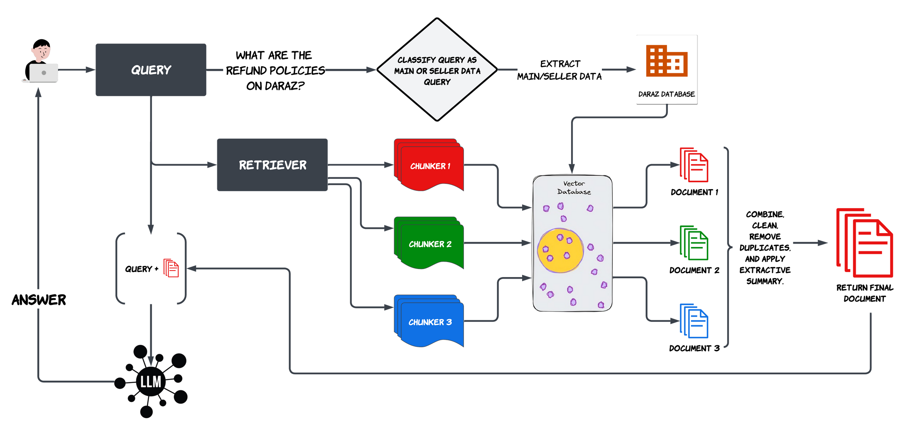
Retrieval on Main/Seller Data

Slide 8
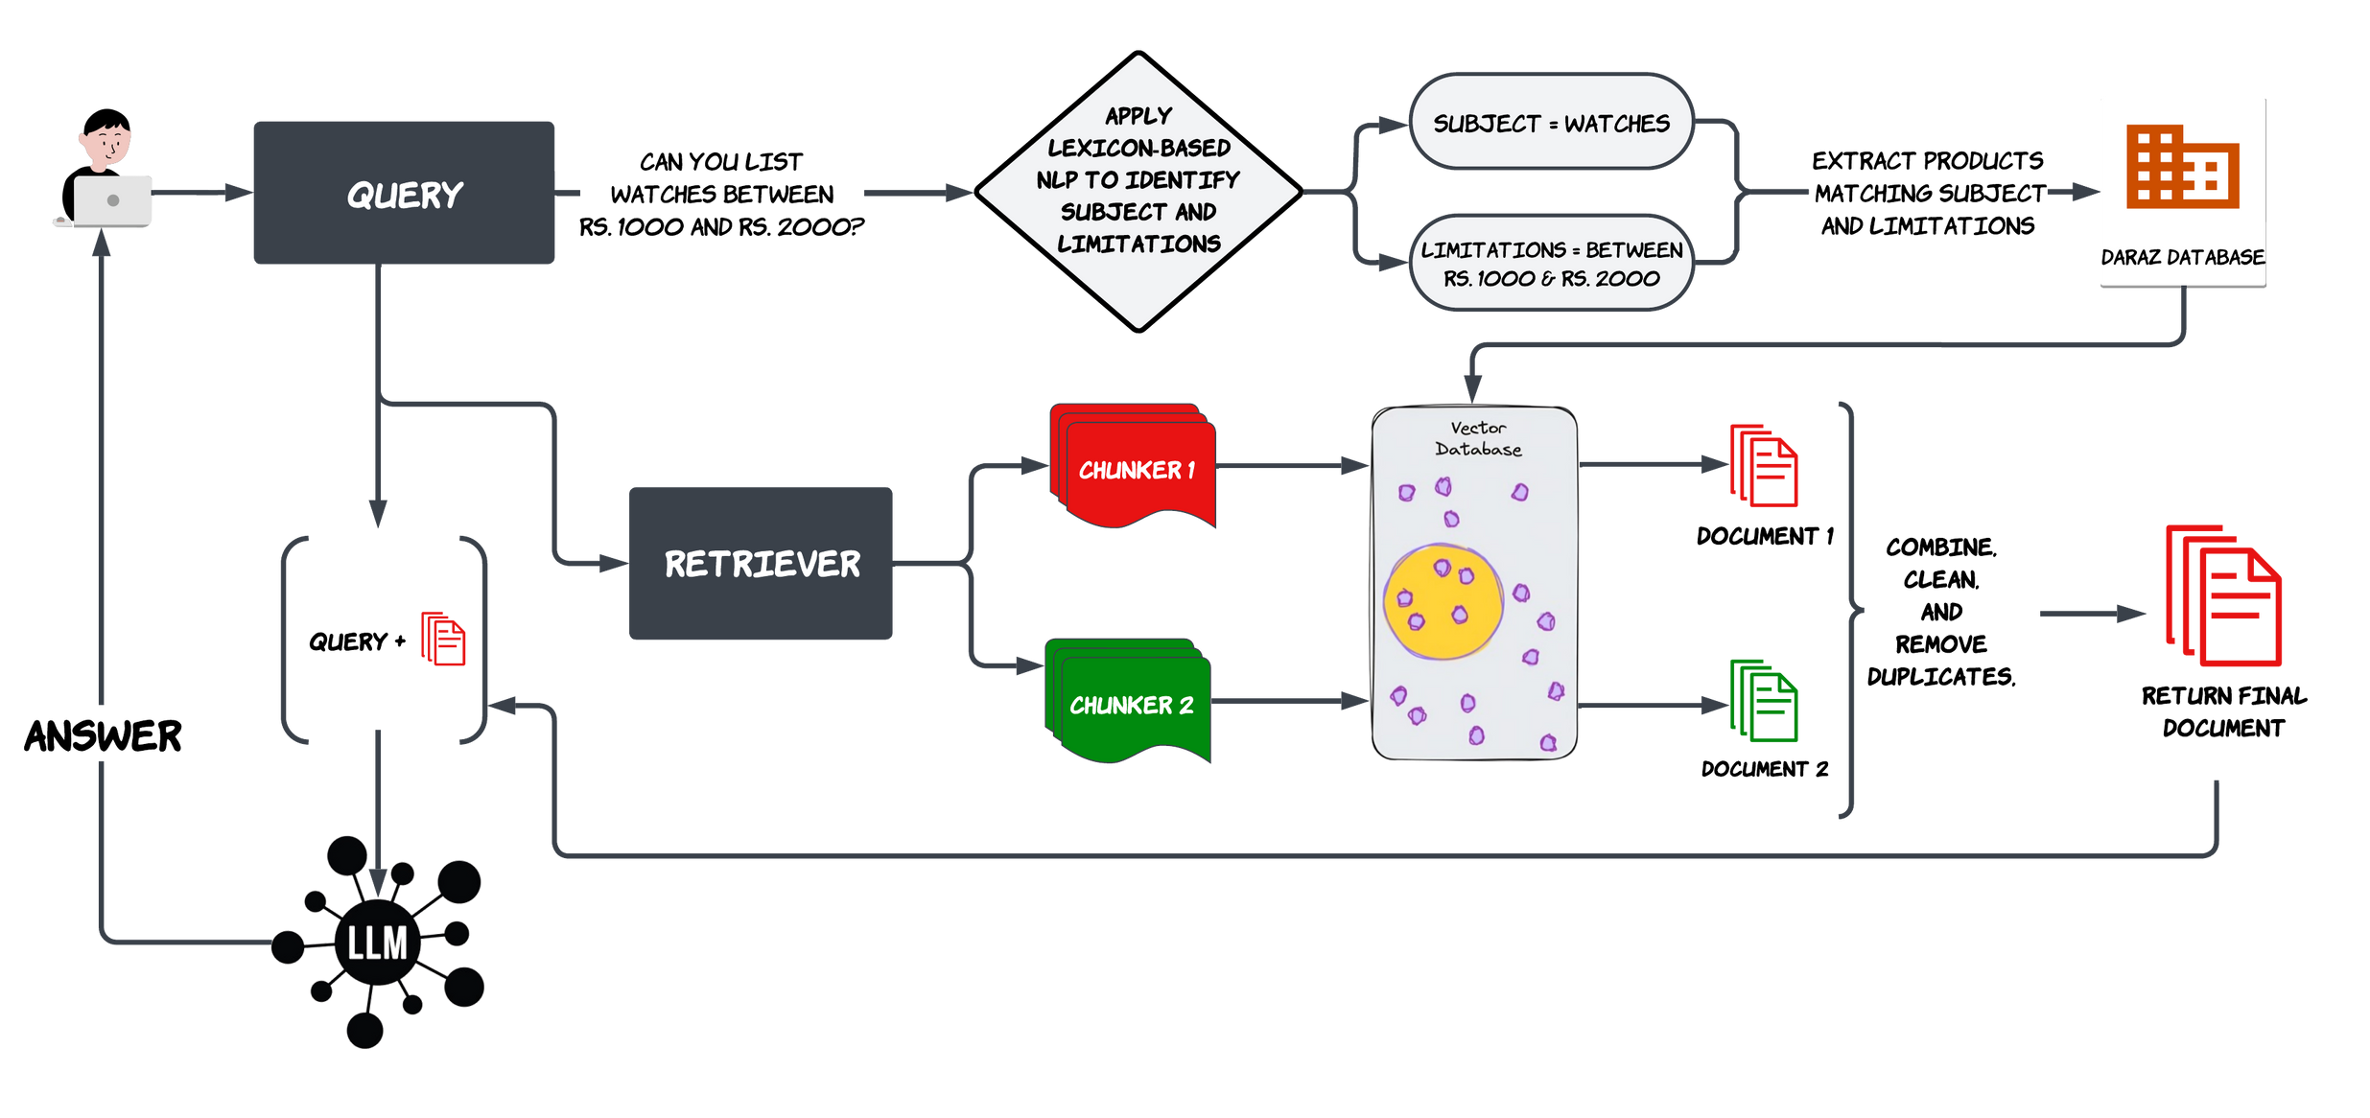
Retrieval on Products Data

Slide 9
LLM Phase

Slide 10
Prompts
Main & Seller
Products
Based on the detailed information below, please provide a comprehensive answer to the customer's query:
{content}
Question: {question}
Your response should comprehensively integrate the information provided, accurately reflecting the key points and offering a clear, well-structured answer.
Customer Question: {question}
Product List:
{content}
Based on the above product list, please provide a helpful and engaging answer that encourages the customer to consider the options and possibly make a purchase. Highlight the key features and benefits of the products listed.

Slide 11

Mistral 7 Billion
Main: "What are your refund policies?"
Daraz's refund policy allows for returns or refunds on items that are damaged, defective, incorrect, or incomplete. However, for device-related issues after usage or beyond the return policy period, it is recommended to check if the item is covered under Seller or Brand Warranty. Items that are non-returnable include any custom-made items. For Buy More, Save More orders, partial cancellations are not permitted, but partial returns are allowed. This means that if you wish to return certain items from a Buy More, Save More order, you can do so, but you would need to cancel the entire order if you want to return one or two specific products. After the returned items have been quality checked by Daraz, a partial refund will be issued to the customer on an item-level basis for each bundle. To submit a return request, customers must do so within 14 days of receiving their order. Decisions on returns and refunds will be taken by Daraz in its sole discretion. Customers attempting to circumvent the terms and conditions and abuse subsidies by creating new accounts will be unable to place their orders.
Seller: "Can I make product bundles on Daraz?"
Absolutely, Daraz allows sellers to create product bundles as a sales promotion strategy. Product bundling is an effective way to differentiate deals from competitors, especially in high-priced categories, and it provides several benefits. Firstly, bundles enable sellers to sell low-cost items together with more expensive ones, offering customers a better value for their money. This can be a great opportunity to clear inventory of certain products. Additionally, bundles are an excellent way to attract customers and increase conversion rates. By selling a package or set of goods for a lower price than the customer would pay if they bought each item separately, sellers can enhance overall performance and boost sales. There are two common types of product bundling: 1. Buy One Get One Free (BOGO): This is a form of sales promotion where the customer receives one product for free when they buy another product. It is not actually half price, but it can be an effective way to generate interest and sales. 2. Combo: This is a promotion where different products are sold together as a set with one or more items at discounted prices. Moreover, if a seller is selling only custom-made products, they should aim to have a minimum of 5 such products in their bundle....
Product: "Can you list watches between Rs. 1000 and Rs. 2000?"
Hello there! I'm glad you're in the market for a new watch and I'd be happy to help you out with some options. Based on your budget of Rs. 1000 to Rs. 2000, I've found three watches that I believe would be of interest to you. First up, we have the Men Quartz Watch with a Car Wheel Rim Hub Design from D&K Online. This watch not only boasts a unique and stylish design but is also waterproof, making it a great choice for those with an active lifestyle. With various discounted prices ranging from Rs. 1768 to Rs. 1868, you're sure to find a great deal. Next, we have the 2022 trend full-automatic quartz movement men's watch from lamgool Electronic. This watch features a sleek and modern design and is a great option for those who want a watch that not only looks good but also functions well. The watch is also automatically wound, making it a convenient choice for those who don't want to have to manually wind their watch every day. With a discounted price of Rs. 1410, this watch is a steal! Lastly, we have the Qiunery YESURPRISE Unisex Antique Case Vintage Brass Rib Chain Quartz Pocket Watch. This watch is a unique and stylish addition to any outfit, and its vintage design adds a touch of...

Slide 12
Zephyr 7 Billion Beta
Main: "What are your refund policies?"
If you receive a damaged, defective, incorrect, or incomplete item, Daraz will assess the situation and issue a refund based on their evaluation. However, for device-related issues that arise after usage or beyond the return policy period, we suggest checking if the item is covered under the seller or brand warranty. Items that are custom-made cannot be returned. In terms of the cancellation and return policy for Buy More, Save More orders, partial cancellations are not allowed, but partial returns are allowed. This means that if you decide to cancel your order, you cannot cancel just one or two products; instead, you must cancel the entire order. However, if you choose to return certain items from your Buy More, Save More order, a partial refund will be issued to you after these items have been returned and quality checked by Daraz. The partial refund is calculated on an item level for each bundle. If you receive your order but are not satisfied with your purchase, you can submit a return request within 14 days from the date it is delivered to you. Daraz will make the final decision on returns and refunds in their sole discretion. Additionally, we want to remind our customers that attempting to bypass...
Seller: "Can I make product bundles on Daraz?"
Yes, you can definitely make product bundles on Daraz. Daraz offers a feature called "Bundles" which allows sellers to create promotional offers by bundling multiple products together and selling them at a discounted price. This is a great way to increase sales, attract customers, and clear inventory. There are different types of product bundling that you can choose from, such as "Buy 1 Get 1 Free" or "Combo" bundles. In "Buy 1 Get 1 Free" bundles, you offer a second product for free when the customer buys a certain product. This is a popular promotion that helps you differentiate your deals from competitors, especially in high-priced competitive categories. Customers are attracted to this type of bundle because they get more value for their money. In "Combo" bundles, you sell multiple products together as a set at a discounted price. This is a great opportunity to sell low-cost items as part of a bundle. It also helps you move slow-moving inventory by bundling it with more popular products. To create a bundle on Daraz, you need to have a minimum of 5 custom products if you are selling only custom-made products. Customers can customize the products according to their preferences, which can help you match customer demand, increase sales, and gain market research. Creating bundles has several benefits, including increasing sales and competitive edge, customer engagement...
Product: "Can you list watches between Rs. 1000 and Rs. 2000?"
Dear valued customer, Thank you for your inquiry, and we're delighted to offer you a selection of watches between the price range of Rs. 1000 and Rs. 2000. We're confident that you'll find a timepiece that suits your taste and budget. Firstly, we have the Men Quartz Watch for Waterproof Vacuum Plating Strap with Car Wheel Rim Hub Design Sport Automatic Wristwatch (Does not rotate) from D&K Online. This watch boasts a stylish design with a sporty edge, making it a perfect fit for those who prefer a more dynamic look. Its waterproof feature ensures that it can withstand splashes and light rain, making it an ideal choice for those who lead an active lifestyle. The watch also features a vacuum plating strap, adding to its durability and longevity. Next, we have the 2022 trend full-automatic quartz movement men's watch wheel non mechanical watch wrist watch fashion men's watch from lamgool Electronic. This watch showcases a modern and sophisticated design with a full-automatic quartz movement, making it an accurate and reliable timepiece. The watch's non-mechanical feature means that it requires less maintenance and is easier to use than traditional mechanical watches. Lastly, we have the Qiunery YESURPRISE Unisex Antique Case Vintage Brass Rib Chain Quartz Pocket Watch Train from Qiunery. This unique and vintage-inspired watch is perfect for those who prefer a more classic and timeless design. Its antique case and vintage brass rib chain add to its charm, making it a stylish and distinctive accessory. The watch's...

Slide 13
Qwen 1.8 Billion
Main: "What are your refund policies?"
Daraz offers a refund policy for any damaged, defective, incorrect, or incomplete items received. The policy states that for device-related issues after usage or expiration of return policy period, the customer may need to check if the item is covered under seller or brand warranty before returning it. Partial cancellations are not allowed, but partial returns are allowed on Buy More, Save More orders, where the customer can return certain items out of their total order and receive a partial refund on an item-level basis. If a certain number of products from a Buy More, Save More order are eligible for a return, partial refund will be issued to the customer after these items have been returned by the customer and quality checked by Daraz. Partial refunds are calculated on item level of each bundle. In case of dissatisfaction with the purchase, customers can submit a return request within 14 days from the day it is delivered to them. Daraz will take a decision on returns and refunds based on its sole discretion. Customers who try to circumvent the terms and conditions and abuse subsidies by creating new accounts will be unable to place their order. Overall, Daraz's refund policy provides customers with peace...
Seller: "Can I make product bundles on Daraz?"
Daraz offers various types of product bundling options such as minimum 5 customs products required for a bundle sale, combo A promotions, and low-cost item packages. The benefits of product customization include matching customer demand, increasing sales and competitive edge, building brand loyalty, and gaining market research insights. By creating bundles, sellers can differentiate themselves from competitors and attract customers who may be interested in purchasing a set of products at a lower price. Additionally, bundle sales can help sellers clear their inventory and reduce costs associated with promoting individual products. Overall, product bundling can be an effective marketing strategy for sellers looking to increase conversions, sales, and overall performance.
Product: "Can you list watches between Rs. 1000 and Rs. 2000?"
Hello there! Are you in the market for a stylish and affordable watch that falls within your budget range? Our product list has got you covered! Let's start with the Men Quartz Watch for Waterproof Vacuum Plating strap with Car Wheel Rim Hub Design Sport Automatic Wristwatch (Does not rotate). This watch comes in four different price options, starting at Rs. 3999. It features a waterproof vacuum plating strap, a car wheel rim hub design, and an automatic sportmatic wristwatch. If you're looking for a more casual option, the 2022 trend full-automatic quartz movement men's watch is another great choice. With its vintage brass rib chain, it's perfect for daily wear or as a gift for someone special. The original price for this watch is Rs. 1836, but we have them all discounted by 14% to Rs. 1410. Finally, if you're looking for something a bit different, the QiuneryYESURPRISE Unisex antique case vintage brass rib chain quartz pocket watch train is a unique and stylish option. It features an antique case, vintage brass ribs, and a quartz pocket watch. The original price for this watch is Rs. 1790, but we have them all discounted by 82% to Rs. 1250. All of these watches are made from high-quality materials and come with a variety of features to keep you comfortable and stylish on the go. So why wait? Shop now and get ready to make a statement with your new watch!

Slide 14
Microsoft Phi 2.7 Billion
Main: "What are your refund policies?"
Thank you for your email. We appreciate your inquiry. Daraz has a clear cancellation and return policy for Buy More, Save More orders. Full refunds are only provided for damaged, defective, incorrect, or incomplete items. If the item is a device-related issue after the return policy period or not covered under the Seller or Brand Warranty, the refund may not be provided. Regarding partial cancellations, Daraz does not allow it. However, customers have the option to return certain items out of their total Buy More, Save More order. If a certain number of products from the order are eligible for a return, a partial refund will be issued after the items have been returned by the customer and checked by Daraz. In case you are not satisfied with your purchase, you can submit a return request within 14 days from the delivery date. Daraz makes the final decision on returns and refunds, and they will be provided in their sole discretion. Customers are not allowed to circumvent the terms and conditions and abuse subsidies by creating new accounts.
Seller: "Can I make product bundles on Daraz?"
Yes, you can create product bundles on Daraz. We have a variety of pre-made bundles that you can use for your product listings. These bundles are designed to help you attract customers and increase sales. By bundling your products together, you can offer customers a better deal and encourage them to make a purchase. Additionally, bundling can help you clear out excess inventory and make the most of your products. You can also create your own custom bundles by selecting the products you want to include and setting the price. This gives you the flexibility to create bundles that are tailored to your specific product offerings. If you have any questions about how to create bundles on Daraz, please let me know and I'll be happy to assist you.
Product: "Can you list watches between Rs. 1000 and Rs. 2000?"
Thank you for reaching out to us! We are happy to assist you in finding the perfect watch for your needs. Our product list includes a variety of options that cater to different styles and price ranges. Here are some key features and benefits of the products listed: - Product 04 is a Men Quartz Watch for Waterproof Vacuum Plating Strap with Car Wheel Rim Hub Design Sport Automatic Wristwatch. It is perfect for those who want a durable and stylish watch that can withstand water and other harsh conditions. - Product 10 is a 2022 trend full-automatic quartz movement men's watch wheel non mechanical watch wrist watch fashion men's watch. It features a sleek design and offers a variety of colors to choose from. - Product 17 is a Qiunery YESURPRISE Unisex Antique Case Vintage Brass Rib Chain Quartz Pocket Watch Train. It has a vintage look and feel, making it a unique and eye-catching accessory. We hope this information helps you in making your decision. Please feel free to ask any further questions or let us know if you need any additional assistance.

Slide 15
Time Analysis
Query Type
Mistral 7B
Zephyr 7B
Qwen 1.8B
Phi 2.7B
Main
9 Minutes, 44 Seconds
11 Minutes, 16 Seconds
4 Minutes, 15
Seconds
2 Minutes, 36
Seconds
Seller
13 Minutes, 19 Seconds
10 Minutes, 16 Seconds
2 Minutes, 18
Seconds
5 Minutes, 27
Seconds
Product
20 Minutes, 19 Seconds
20 Minutes, 46 Seconds
4 Minutes, 44
Seconds
5 Minutes, 47
Seconds

Slide 16

THANK YOU!

